Slide 1



Slide 2
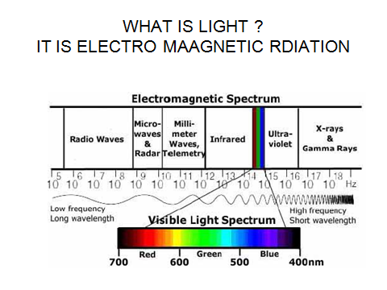
Illumination

Slide 3
ILLUMINATION
Illumination is the light incident on the surface of the object.
No single factor is of more importance to the mining industry than lighting.
Under natural conditions it is always dark below
ground, and all light must be produced artificially.
Furthermore, mining is a hazardous calling requiring a continual state of awareness and ability to recognize danger from many sources

Slide 4
Lighting is vitally necessary underground, and it is usually very important to ensure that there are no failures , and that the lamp used is as efficient as possible — both for safety and for good morale.

Slide 5
A man can work efficiently and give satisfactory results only if he can see
what he is doing and is not hampered by inadequate illumination or annoying shadows.
Lighting has a serious effect upon morale and plays an important part in improving operating conditions below ground.

Slide 6
emphasis was generally laid upon the economic
factors involved, and lamps were operated as cheaply as possible.
The main difficulty arises from the presence below ground of inflammable gas, which requires all the lamps and fittings used
to be specially designed to eliminate the risk of ignition.
Such equipment and may prohibit the general use of mains-fed equipment.

Slide 7
The second important obstacle is the nature of the surface surrounding the working places.
In their natural states these are dark in colour and are highly absorbent to the light falling upon them.
Coal absorbs about 95 % of the incident light,
shale and carboniferous rocks, about 75%; and
props, etc., about 85%,
compared with some 40% absorbed by whitewashed surfaces.

Slide 8
The problem is also aggravated by the restricted and congested nature of the working places.
The roadways comprise comparatively narrow tunnels which are not easy to illuminate without glare.
Coal-faces are frequently low in height and the
presence of machinery and roof supports, all of which cast shadows, make even illumination virtually impossible.

Slide 9
The only solution here appears to lie in the use of larger light sources, but
the avoidance of undesirable extremes of light and dark and of glare is difficult, and the best result can be obtained only by compromise.

Slide 10
One of the principal difficulties in assessing visibility in mines
lack of agreed standards and methods of assessing the parameters involved;
attempts are to be made to achieve international agreement on this matter.

Slide 11
One adverse effect of insufficient lighting in mines is the incidence of the eye disease of miners' nystagmus.
This is usually evidenced by oscillations of the eyeballs,
slow adaptation of the eyes to both light and dark and other neurotic effects..
The sufferers also have a marked dislike for bright light

Slide 12
'portable lighting' includes those systems
which involve units carried by the users,
as distinct from permanent and semi-permanent fittings requiring a mains source of power.

Slide 13
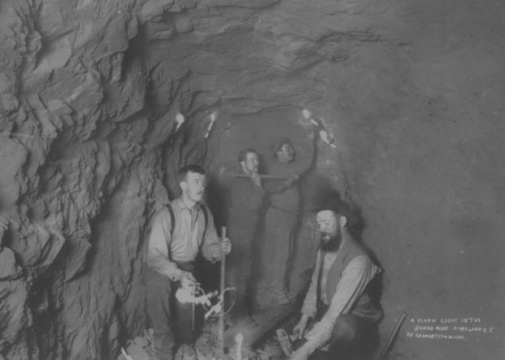
Candle light with holder

Slide 14

Oil wick lamps improved safety
by containing open flames. Costs
were also lower, and miners
found them easier to use than
candles.
Oil wick lamps improved safety
by containing open flames. Costs
were also lower, and miners
found them easier to use than
candles.

Slide 15
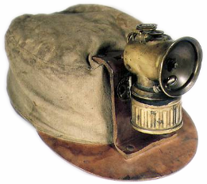
Carbide lamps
The transition to helmet-mounted
lighting began with the introduction
of the carbide lamp.
The transition to helmet-mounted
lighting began with the introduction
of the carbide lamp.

Slide 16
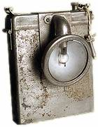
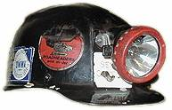
Incandescent Lights
The introduction of the
incandescent lamp eliminated
concerns about open
flames within the mine.
The light from a small, steadily
burning incandescent filament
was much more controllable
than the light from an open
flame. Enclosed within a
directional reflector, it became
the standard, unchanged to
this day.

Slide 17

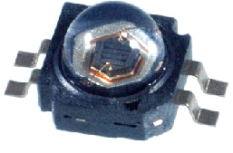
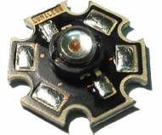
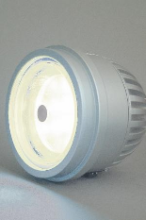
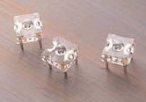
Light Emitting Diodes (LEDs)
LEDs are semi-conductors; they don't have a filament that will burn out.
They are illuminate by the movement of electrons in a semiconductor.

Slide 18
Cap lamps
Cap lamp or lamp : The complete lighting set.
Battery : The electricity storage unit, usually carried on a belt and consisting of two lead-acid cells.
Cell : One lead-acid unit consisting of positive and negative plates, and nominally two volts.
Headset : The part that normally attaches to the helmet

Slide 19
The lead-acid battery has many advantages over other rechargeable batteries
the most important : fairly high power to weight ratio; low cost; high electrical efficiency : flat discharge voltage characteristics; simple self-service charging capability; and finally, the electrolyte is far less dangerous than
that used in alkali batteries,
On the other hand, lead-acid batteries are perhaps more susceptible to incorrect charging than alkali types, though if the right method is used overcharging cannot occur and reliable performance should be obtained

Slide 20
Modern lamps have a capacity of over 10 Amp-hours, weigh less than 2.5 Kg, and are extremely
reliable if correctly treated

Slide 21
Cap lamps are constructed with the bulb carried in a headpiece
affixed to the user's helmet, while the battery, supported by
a belt, is carried on the miner's back.
Headpieces are of plastic or metal, and bulb and reflector assemblies are of similar design in all types.
Features of the newer models are their compactness and light weight.
It is important that the weight should be small and the centre of gravity should be as near to the helmet fixing as possible
The lens glasses are of armoured glass approved by the
Regulatory authorities, and they must carry an appropriate
marking.
Lens rings are of metal or plastic and screw or clip into position

Slide 22
Construction of cap lamps
A cell in a cap lamp battery consists of three plates held apart by porous separators and surrounded by a strong shock resistant case which also serves to contain the acid electrolyte (see Fig. 1a).
The centre plate is the positive plate which when charged is mainly lead dioxide (PbO2 ). The construction of modern positive plates is tubular, each tube — as shown in Fig.— consisting of an antimonial lead alloy spine (for strength) surrounded by the active material which is packed as a powder into the outer sleeves that hold it together.
The two outer plates are formed from the negative active material, lead (Pb). These plates are described as being of pasted construction since part of the manufacturing process consists
of making a paste of lead compounds,
sulphuric acid, and various additives, which are then formed onto the basic grids of the plates
Modern separators are highly absorbent in order to reduce as far as possible the free electrolyte in the cell, and are now exclusively synthetic. Their thickness means that the internal resistance of a cell is fairly high when compared to other types of lead-acid cells - being about 0.05 ohms

Slide 23
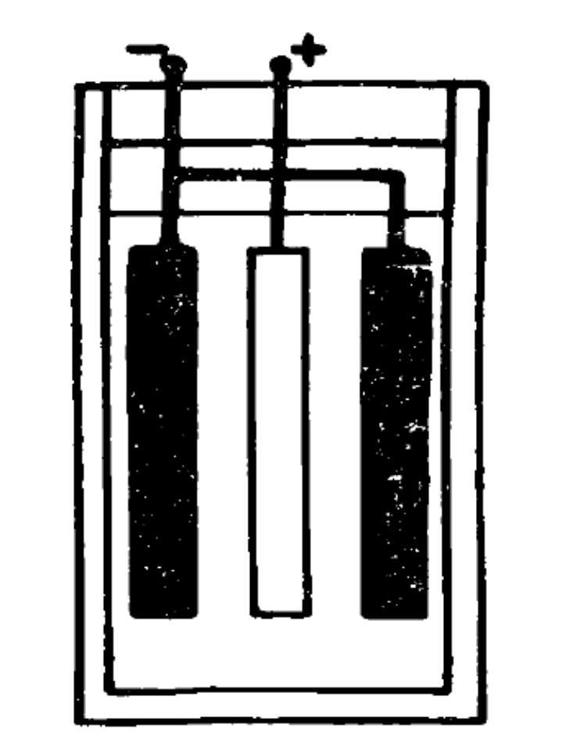

Slide 24
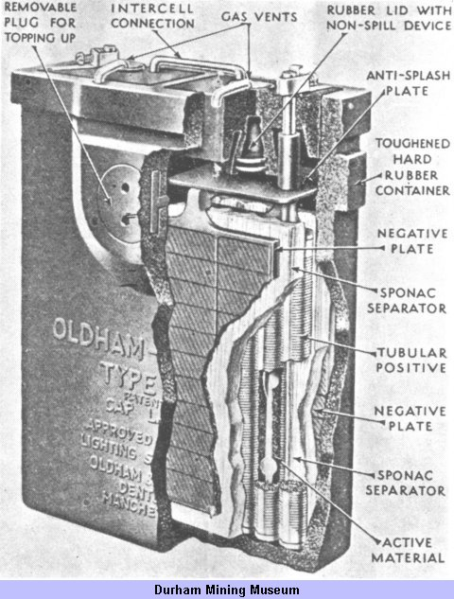

Slide 25
The cases of batteries are moulded in hard synthetic rubber or plastics such as polycarbonate. Incorporated in all capjamp batteries are topping-up holes and non-spill vents which allow any gas released during charging to escape, but keep acid inside the cells even if the battery is inverted.
The acid electrolyte is approximately 20% sulphuric acid of high purity, and batteries are normally protected by a two or three
ampere fuse.
The non-spill vents are only effective if the electrolyte level is correct.
Acid leak from the vents may be noted after the battery has been immersed in water, since the cooling of the air inside the battery
causes water to be forced in, hence diluting and contaminating the electrolyte.
The electrolyte level rises, so leakage occurs, especially during charging.
This can be avoided by blocking or covering the vents before
immersion (taking care that any thing used cannot be sucked up into the battery).
The vents must be cleared before charging.

Slide 26
The Discharge Process
A fully charged cell has the positive active material PbO2 , the negative active material Pb, and the electrolyte at its strongest with a specific gravity of about 1.29 (pure water has a s.g. of 1.00).
When put on load — that is, when the lamp is switched on — each cell will begin to discharge from a starting voltage of nominally 2 volts.
During discharge, the positive and negative plates are transformed slowly into lead sulphate (PbSO4) as shown
The sulphur in this compound must of course come from the sulphuric acid, so the electrolyte becomes more diluted with the s.g. dropping eventually to about 1.10 during a normal discharge.
In general purpose lead-acid batteries the specific gravity is a very accurate guide to the state of discharge, however in cap lamp batteries there is very little free electrolyte, and so measuring the s.g. is not usually a practical proposition.

Slide 27
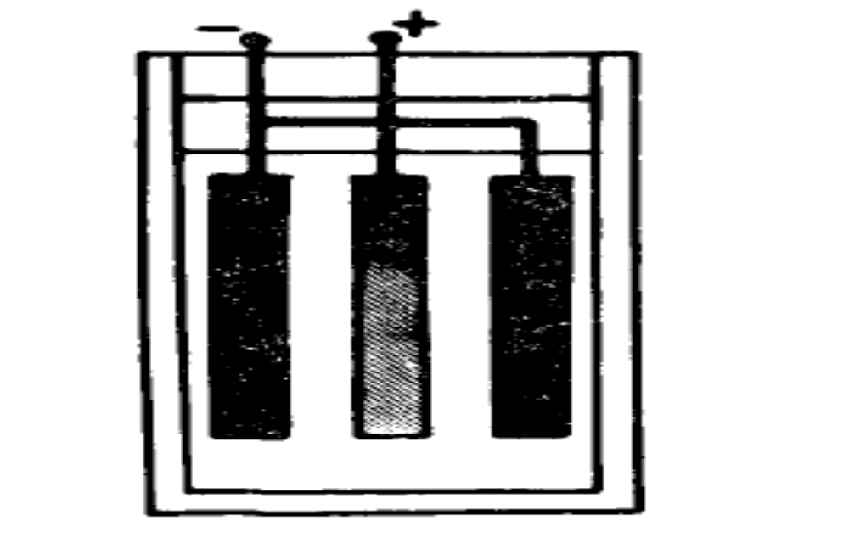
b) Discharging .Increasing PbSO4in all plates.
Electrolyte decries in strength.

Slide 28
The chemical formula for the discharge process is simply:
PbO2 + Pb + 2H2SO4 -• PbSO4 + PbSO4 + 2H2O
or more fully:
PbO2 + 2Hr-+ PbO + H2O + 2 © ) Positive Plate
And PbO + H2SO4 -* PbSO4 + H2O J
Pb + SO4 -> PbSO4 + 2 © Negative Plates

Slide 29
During this process the internal resistance of a battery rises from about 0.1 to 0.15 ohm, the actual value depending on its condition and age —
in general a battery which is old or in bad condition will have a higher internal resistance.

Slide 30
A typical discharge curve is shown . Batteries should not normally be discharged below 1.7 volts per cell at which point the main beam will be noticeably dimmer than full brightness.
If discharged below this voltage, the battery should be recharged as soon as possible as otherwise sulphation will become pronounced far more quickly than usual.
In addition sulphation will occur in normal use if a battery is left in a discharged state for long periods —It will be seen from the discharge curve that the battery voltage remains close to 4 volts for most of the time.
This is an important point as it means that bulbs can be used close to their optimum operating point for most of the period of discharge, which makes for high lighting efficiency.

Slide 31
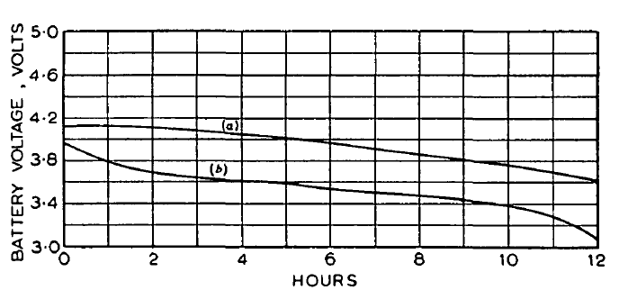
Voltage discharge curves of batteries
(a) Lead-acid battery discharging through 0-8 amp (rating) bulb.
(/>) Nickel-cadmium battery discharging through 1 0 amp (rating) bulb

Slide 32
It will be seen from the discharge curve that the battery voltage remains close to 4 volts for most of the time.
This is an important point as it means that bulbs can be used close to their optimum operating point for most of the period of discharge, which makes for high lighting efficiency.
The electrical power efficiency of a lead-acid battery is extremely high. 75% of the power put in during charge may be used on discharge,.
The amp-hour efficiency (Amp-hours output/Amp-hours input) is even higher — typically 90%.
The efficiency and capacity of a battery is reduced at low temperatures, both being as much as 10% less at 0°C than at 15°C.

Slide 33
Reflectors are generally of anodized aluminium, although treated plastic reflectors are also in use. The shape of the reflector is approximately parabolic and the light distribution is determined by the degree of matting of the reflector surface.
Generally, a semi-matt finish having a reflector ratio of 25 : 1 *
is deemed suitable for the ordinary workman, but polished
reflectors with ratios of 50 or 100 : 1 are in use for officials and
specialized tradesmen and are increasingly used by men engaged
in mechanical mining operations
* The reflection ratio of a cap-lamp reflector is the ratio of the maximum candlepower of the beam (usually at or near the centre) to the average candle-power over the solid illuminated angle

Slide 34
Main bulbs used in cap lamps may have either single or double
filaments, and are filled with krypton; the light output is about
40 lumens.
Some cap-lamp headpieces include a small auxiliary
bulb having a lower current rating than the main bulb, which acts
as a standby in case of failure of the main filament and can be
used to conserve the charge of the battery in an emergency.
Alternatively, the auxiliary filament may be included in the main
bulb, but it is generally accepted that a second filament is advisable.
A switch is usually incorporated in the headpiece, to select the
main or pilot filament or the 'off' position.

Slide 35
The headpiece must be locked against unauthorized opening
by a magnetic lock, lead seal or special shrouded screw covered
with a wax seal.
The headpiece is connected to the battery by a cable of specified design
The characteristics of the cable are important, since the performance and the safety of the lamps are dependent upon it.
very satisfactory cables are available which has an average life of 2-3 years, dependent upon the severity of the conditions of its use.
The cable is secured to the headpiece and battery in a variety of ways in different lamps, but in all cases the arrangement must be
strong enough to withstand a steady pull of 20 kgs.

Slide 36
Lead-Acid Batteries for Cap Lamps.
The lead-acid batteries used with cap lamps are of two types,
differing principally in the design of the positive plates.
One type of battery has tubular positive plates in which the active
material is packed around lead splines and retained by slotted
rubber tubes.
The other type employs flat positive plates of the pasted-grid type. The negative plates in both batteries are flat,
the grids being in the form of a lattice.
The separators are highly absorbent, so that there is little free acid in the battery. The latter feature, coupled with a special venting arrangement, provides an unspillable battery which 'breathes' to atmosphere.
It is possible to charge such batteries without dismantling the lamps

Slide 37
The positive and negative plates are housed in a hard-rubber box which constitutes the outer container.
Topping-up with distilled water is accomplished by removing a filler plug and gasket on the side of the battery, which uncovers two holes giving access to the two cells.

Slide 38
A typical discharge curve for a 4-volt lead-acid cap-lamp battery, supplying a bulb with a nominal current of 0-8amp, is
shown in Fig.
The normal working shift is about 8 hours, so that it will be seen that such a battery has an ample margin of capacity

Slide 39
Battery covers are secured in a relatively permanent manner, usually by special shrouded screws with wax seals, since it is
necessary to remove such covers only every 3-6 months. for maintenace.

Slide 40
Alkaline Batteries for Cap Lamps.
The alkaline batteries used in cap-lamps to-day are
usually of the 3-cell type.
Two makes of cap lamp incorporate 4-cell batteries, but they are not widely used.
The cells are of the nickel-cadmium and nickel-iron types, the groups and electrolyte being carried in steel containers sheathed in rubber sacks.
The three cells are connected in series and housed in an outer steel container.

Slide 41
The plates may be of the pencil type, in which the active material is carried in a number of pencil-like tubes,
or flat, with strip pockets to contain the active material.
A typical discharge curve for an alkaline cap-lamp battery is
shown in Fig.
The load applied is the normal current of the appropriate bulb, namely lamp.
Again it will be seen that the discharge period can be considerably longer than a normal working shift of some 8 hours.
The battery cover houses the contacts, a fuse, a cable lock, the
gassing vents and filler holes.
The gassing vents are normally closed during discharge, so that the cover, usually secured with a magnetic lock, must be removed for charging

Slide 42
Charging of Lead-Acid Batteries for Cap Lamps.
Lead-acid cap-lamp batteries are invariably charged in parallel on a modified constant-voltage system, the low-voltage d.c.power necessary (at about 5-6 volts) being obtained from a transformer-rectifier unit.
Adjustment of the output voltage to suit variations in mains voltage or load current is achieved by tappings
on the transformer primary.
The voltage applied to the batteries with this system of charging is critical to about ±100mV; any larger variation may cause an excessive total charge with consequent shorter battery life,
or may result in the battery not receiving a complete charge.

Slide 43
The taper charge, which is controlled by the balance between the frame voltage and the battery e.m.f., should be such that when the battery is fully charged a small residual current flows into the battery.
Such an arrangement is fundamentally necessary for a full self-service lamproom system.
Various methods have been adopted to connect the lamps to the charging circuit, all of which must allow the lamps to be perfectly safe against open sparking in normal usage.

Slide 44
The first is a mechanical switching arrangement with one live contact on the exterior of the headpiece and the other obscured by a lock barrel which is turned by a live key on the charging frame to form the negative feed to the battery.
A second mechanical device operates on the principle of a telephone jack-plug; the socket arrangement offers obscured contacts on the battery cover and the plug is on the charging frame.

Slide 45
A further arrangement for charging has two contacts on the
exterior of the lamp.
One of these is always live and the other is connected to the battery through a small metal rectifier, which allows the charging current to flow into the battery but blocks any return flow which might be dangerous.
In one make of lamp the rectifier is housed behind the reflector in the headpiece, and serves also to convert the single-phase power into the d.c. power necessary for charging.
Another make has the rectifier housed under the battery cover

Slide 46
Charging Alkaline Cap-Lamp Batteries
Charging of alkaline cap-lamp batteries is by constant current,
Numbers of the batteries being connected in series.
The charging current is prescribed by the manufacturers, and the period of charge is related to the number of hours which the lamp has been in use.
The charging stands are so arranged that they can be fed with direct current, which may be at 110 volts
or 220 volts.
In older installations, the direct-current supply is
obtained from motor-generator sets, but in modern plants mercury-arc rectifiers are used.

Slide 47
LAMP ROOM
The l.v. constant-voltage charging employed with lead-acid
batteries permits the use of the 'self-service' system
of lamp-room organization, in which the user himself puts his
lamp on charge and removes it from the rack again when proceeding to work.
A typical layout for a lamp-room of this type is shown in Fig..
The route followed by the men is indicated, and it will be noted that provision is made for a one-way-traffic system, which is advisable to avoid congestion when large numbers of men have to pass through the lamp-room at the same time.

Slide 48
The advantages of the self-service system
(a ) The lamps require a minimum amount of handling, which
results in a saving in labour and in less damage to equipment, particularly to bulbs.
    The lamp-room personnel are able to devote themselves to the important operations necessary to maintain a high safety and lighting standard.
(b) `The men do not have to queue, which results in more orderly
conduct at change of shift times.
(c) Each man has his own lamp and puts it on charge; he thus
takes a greater interest in it, which results in better maintenance and less damage.
(d) The size of lamp-room required for self-service is less than for
    hand issue

Slide 49
Lamp rooms for alkaline batteries
A modified form of self-service sometimes termed 'self-help'
is used in some lamp-rooms with lamps having alkaline batteries.
In this system the men enter the lamp-room and place their
lamps in convenient storage racks from which the attendants
remove the lamps or batteries for charging, replacing them before
they are required for use again.
Such a system differs from the self-service scheme for cap lamps with lead-acid batteries, because, in general, alkaline batteries are not charged at constant voltage and the lamps must be opened before the batteries can be put on charge.
A typical self-help layout is shown in Fig. 5.

Slide 50
Maintenance of Miners' Lamps
Serviceability is influenced by design factors, but good maintenance
basically depends upon the ability and keenness of the
personnel in the lamp-room. Obviously, training can play a
predominant part here, and it is pleasing to note that instructional
courses for lamp-room employees are being arranged in many
parts of the country.

Slide 51
Relative Performance of Miners' Lamps
Through the attention devoted to the design of batteries, bulbs and switch contacts and to reflector finish, etc., the performance of miners' cap-lamps has steadily.
The best method of assessing the efficiency of a cap lamp as a light-producing medium is to consider its light-output/weight ratio,
i.e. the ratio of the light output from the lamp at the end of a shift to the weight of the complete lamp

Slide 52
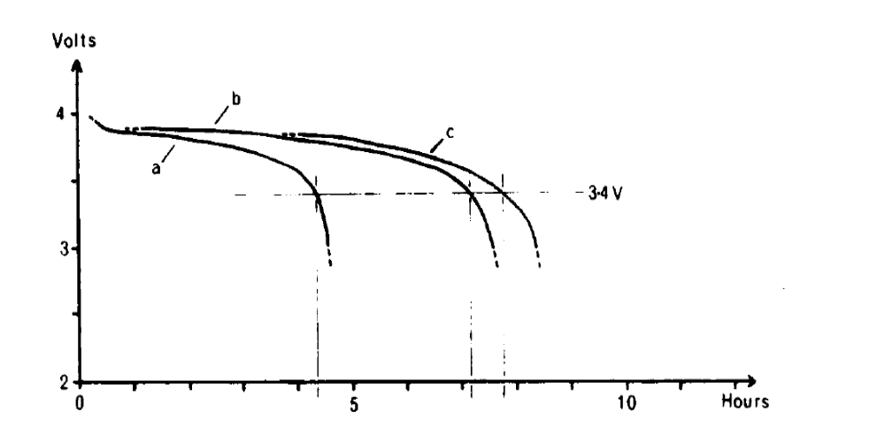
DISCHARGE CURVES
Discharge curves of a sulphated battery.
a) initial discharge curve.
b) after a reconditioning charge.
c) after a second reconditioning cha

Slide 53
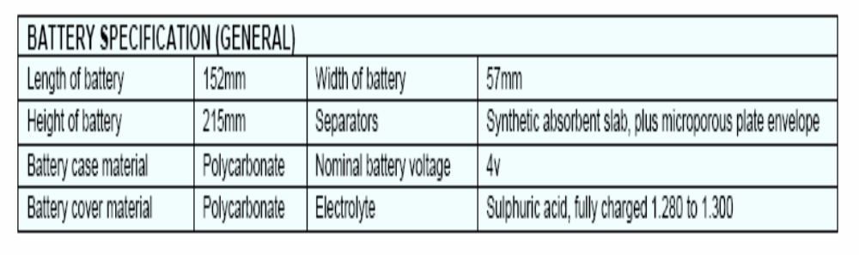

Slide 54

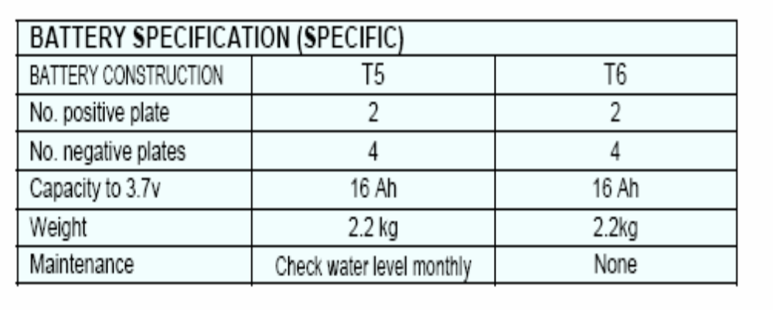

Slide 55
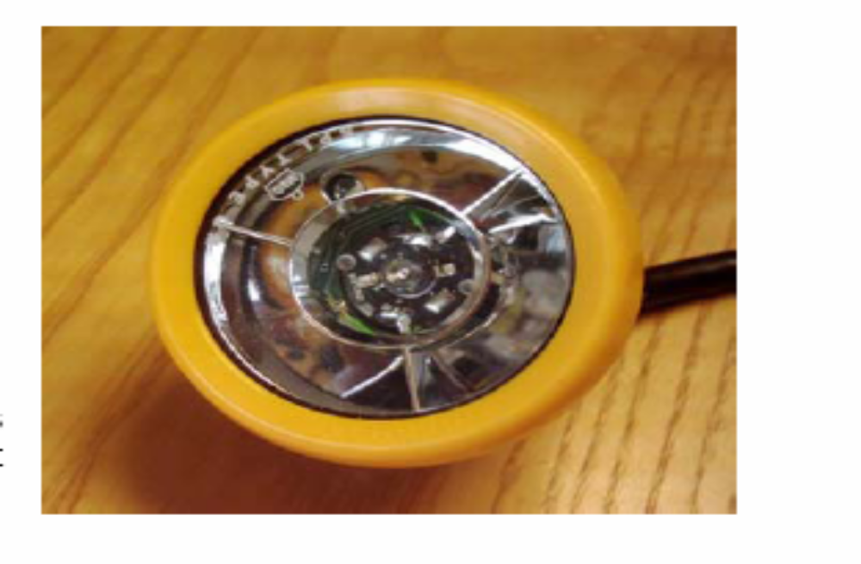

Slide 56
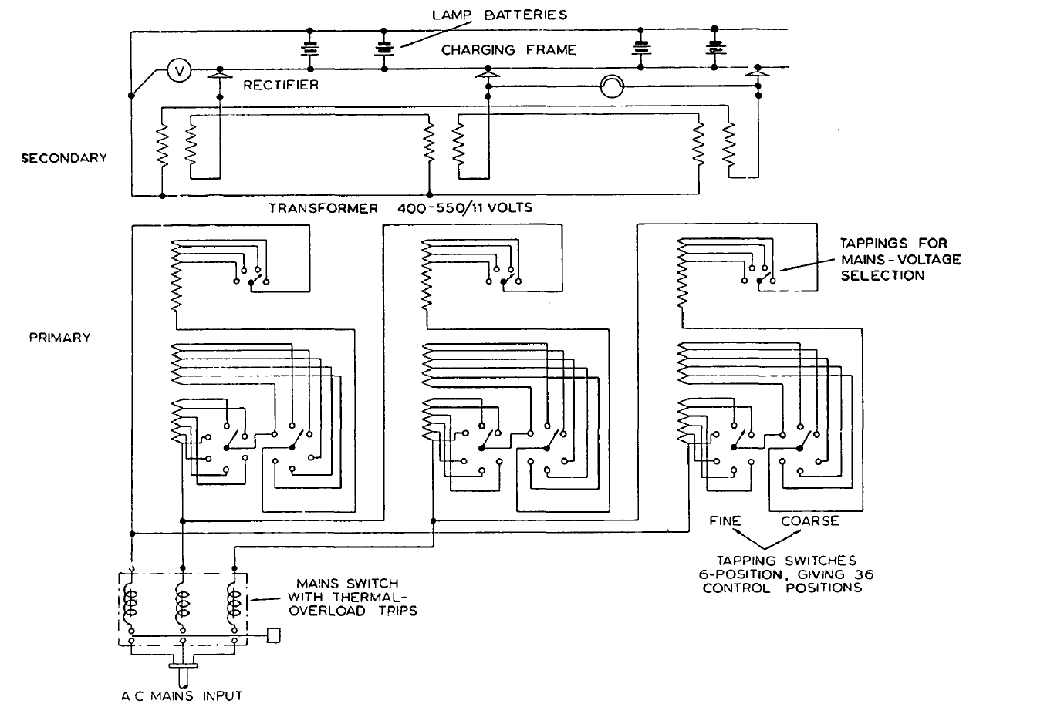
Charging circuit for cap lamps
Charging plant for lead-acid cap-lamp batteries

Slide 57
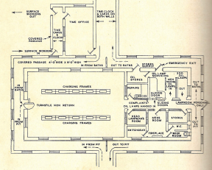

Slide 58
